Slide 1

Department of Information Technology NBA Accredited
A.P. Shah Institute of Technology
G.B.Road,Kasarvadavli, Thane(W), Mumbai-400615
UNIVERSITY OF MUMBAI
Academic Year 2020-2021

Slide 2
A Project Report on IOT ENABLED GAS LEAKAGE DETECTION SYSTEM Submitted in partial full fill ment of the degree of Bachelor of Engineering(Sem-8) in INFORMATION TECHNOLOGY By Shailesh Maurya (17204008) Sankalp Patil (15104030) Akash Sapkal (16204035) Under the Guidance of Prof. Apeksha Mohite Prof. Sonal Jain

Slide 3
1.Project Conception and Initiation

Slide 4
1.1 Abstract
The aim of this project is to present such a design that can automatically detect and also stop gas leakage in vulnerable premises
To stop accident associated with the gas leakage is to install gas leakage detection kit at vulnerable places.
Gas leakage is a major problem with industrial sector, residential premises and gas powered vehicles.
Gas leakage system consist of GSM module, which warms by sending SMS.
The Particular gas sensor has been used which has high sensitivity for Propane(C3H8) and Butane(C4H10).

Slide 5
1.2 Objectives
To layout and acquire project that will perceive gas outflow like Methane leak, Butane leak, and LPG leak, Methane outflow or any such petroleum cantered on gaseous substance that can be discovered using MQ2 device.
To layout and set up an SMS cantered Alert method send SMS alert missives to restrict mobile number enter inside the Arduino program.
To layout and acquire a project that will fabricate a sound alarm during gas outflow and rest the alarm once gas outflow is regulated .
To show status in an LCD using a 16×2 LCD component and also on web server using EPS8266 and to resist the gas supply using Solenoid controller.

Slide 6
1.4 Literature Review
Paper Title : An IoT based System for Domestic Air Quality Monitoring and Cooking Gas Leak Detection for a Safer Home
Authors: Kalpesh Gupta, Gokul Krishna G and Anjali T
Publication details : International Conference on Communication and Signal Processing, July 28 - 30, 2020, India
Findings: In this paper author has suggested a low cost low power system which will measure the concentration of CO2 in the indoor atmosphere also detect the leakage of the LPG or CNG (in situations like forgetting to switch off the stove or accidental turn on the gas stove by someone or accidental leak etc.
Advantages: Proposing a hybrid low cost low power IoT based system for air quality determination and cooking fuel leak detection, enhancing the safety of the users in the house.
Disadvantages: In this system a person only get's notification about the gas leakage but no preventive measures taken to Stop the gas leakage.

Slide 7
1.5 Literature Review
Paper Title : Automatic Smart and Safety Monitoring System for Kitchen Using Internet of Things
Authors: Harika Pudugosula Student, Master of Technology Computer Science and Engineering Amrita School of Engineering, Bangalore Amrita Vishwa Vidyapeetham, India
Publication details : Proceedings of the International Conference on Intelligent Computing and Control Systems (ICICCS 2019) IEEE Xplore Part Number: CFP19K34- ART; ISBN: 978-1-5386-8113-8
Findings: The main purpose of the paper is that to identify, address the safety of kitchen. This smart and safety monitoring system is model by these types of sensors namely, DTH11 sensor monitors temperature and humidity of the kitchen, IR flame sensor detects the existence of fire in the surroundings of kitchen and the leakage of gas in the kitchen is detected by using MQ-3 sensor. The interfacing of these sensors is done by using Arduino UNO and the controlling of this safety system is done by relay.
Advantages: The sensor used in this model can sense and detect the leakage of the gas, and the user gets notification regarding gas leak.
Disadvantages: To uploads the value into web server it requires the Wi-Fi module.

Slide 8
1.6 Literature Review
Paper Title: Gas Leakage Detection Based on IOT
Authors: Suma V, Ramya R Shekar, Akshay Kumar A
Publication details: Proceedings of the Third International Conference on Electronics Communication and Aerospace Technology [ICECA 2019] IEEE Conference Record # 45616; IEEE Xplore ISBN: 978-1-7281-0167-5
Findings: This paper that put forth a new proposed system which is microcontroller based application of gas booking and gas detection systems using IOT. The sensor used in this model can sense and detect the leakage of the gas, and the user gets notification regarding to remaining percentage of gas in the cylinder as well certain action can be taken to pre-book the new cylinder without any barrier
Advantages: The proposed system is not only capable of Sensing or detecting the gas leakages as well as alerting the user about the gas leakage by buzzer alarm and sending notification to the user in the other side automatic LPG booking is allowed this is done by using load cell.
Disadvantages: In this system her only get's notify if gas leakage is detected or the gas cylinder is empty but the user cannot monitor the actual values.

Slide 9
1.7 Problem Definition
Gas leakage leads to various causality resulting into both financial loss as well as human life.
In human’s daily life, environment plays a vital role in health issues. The risk of fires, suffocation, explosion all are based on their physical properties such flammability, toxicity etc.
The number of deaths figures due to explosion of gas cylinders has been increasing in recent years.
The main reason for such explosion is due to sub-standard cylinders, worn out regulators, old valves and lack of awareness using gas cylinders add to risks.

Slide 10
1.8 Technology stack
HARDWARE
Arduino
GSM Module
LCD Display 16*2
Buzzer
ULN2803 IC
PCB Board
Solenoid Valves
Node MCU
ESP8266
Resistors
SIM Card
Potentiometer

Slide 11
1.8 Technology stack
SOFTWARE
Operating System: Windows XP/2000/Vista/7/8/10 or Linux or MacOS
Languages used: PHP, HTML, CSS
Algorithm Used- Shuffling Algorithm
Database:- MySQL Database
Browser:- Testing Environment
WAMP or XAMPP Server

Slide 12
2. Project Design

Slide 13
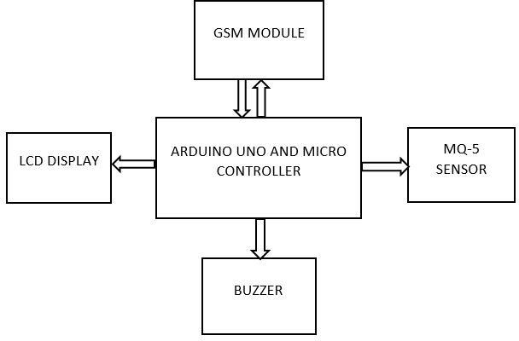
2.1 Existing System Architecture/Working

Slide 14
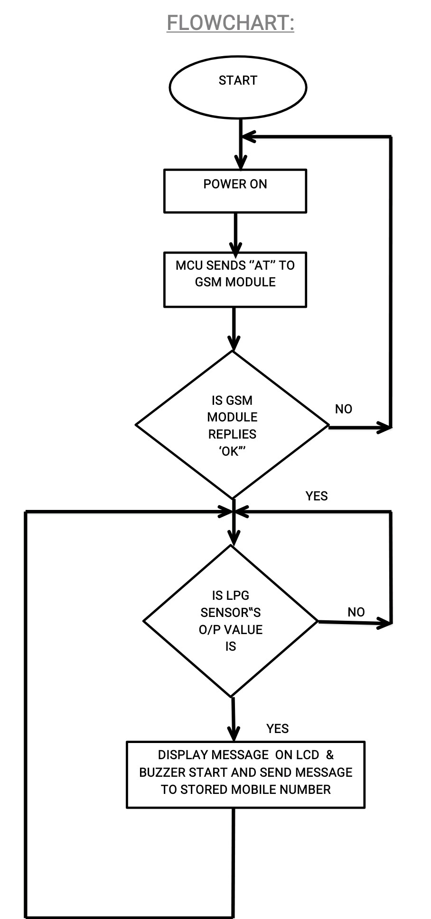
2.2 Existing System Architecture/Working

Slide 15
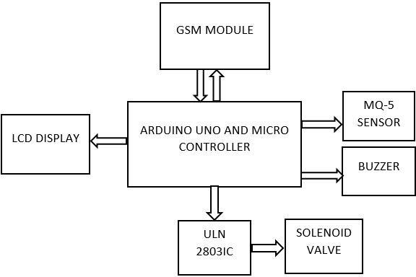
2.3 Proposed System Architecture/Working

Slide 16
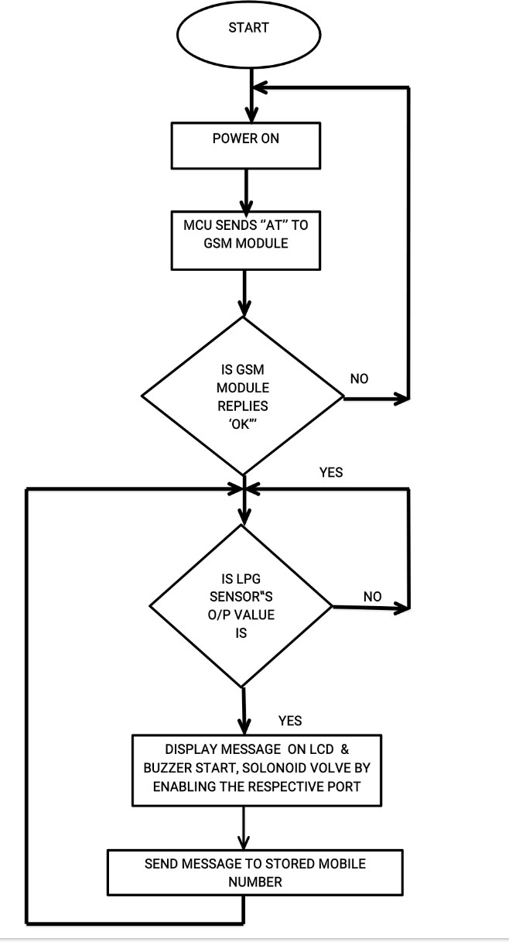
2.4 Proposed System Architecture/Working

Slide 17
2.5 Webserver
A webserver is developed for continuous monitoring of the sensor's value. ESP2866 makes an HTTP post request to a PHP script to insert sensors value into a database.
A specific domain name and hosting space are required for reaching out to the webserver.
A MySQL database is prepared for storing data from the sensors. A PHP script is developed for inserting the data into the MySQL database.
The user can monitor the value of the sensor from anywhere by accessing the
web address

Slide 18
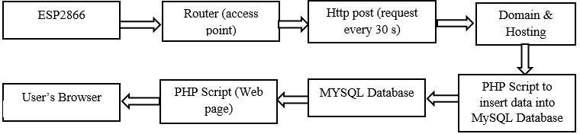
2.6 Webserver Process Block Diagram

Slide 19
2.7 References
Kalpesh Gupta, Gokul Krishna G and Anjali T. “An IoT based System for Domestic Air Quality Monitoring and Cooking Gas Leak Detection for a Safer Home” in International Conference on Communication and Signal Processing, July 28 - 30, 2020, India.
Harika Pudugosula Student, Master of Technology Computer Science and Engineering Amrita School of Engineering, Bangalore Amrita Vishwa Vidyapeetham, India “Automatic Smart and Safety Monitoring System for Kitchen Using Internet of Things” in Proceedings of the International Conference on Intelligent Computing and Control Systems (ICICCS 2019) IEEE Xplore Part Number: CFP19K34- ART; ISBN: 978-1-5386-8113-8
Suma V, Ramya R Shekar, Akshay Kumar A. “Gas Leakage Detection Based on IOT” in Proceedings of the Third International Conference on Electronics Communication and Aerospace Technology [ICECA 2019] IEEE Conference Record # 45616; IEEE Xplore ISBN: 978-1-7281-0167-5

Slide 20
4. Conclusion and Future Scope

Slide 21
4.1 Conclusion
In our work, to acquire the quickest notification of a gas leak, use IOT (Internet of Things).
To get the fastest response from the module, have also used an IOT-enabled website or application.
Other modules and items utilized in this project include a GSM module, a microcontroller, an LED for indication, a buzzer to alert nearby residents, and an MQ 5 gas sensor module to detect gas leaks.
To eliminate accidental gas leaking, have utilized a solenoid valve to turn off the cylinder regulator knob.

Slide 22
4.2 Future Scope
This system can be furthermore upgraded to a compact version where aa mini-speaker can be used, less wiring, and many other similar upgrades can be made.
The current system helps us in continuous monitoring of gas values and Futher it can modified for sending notification with the help of GSM module.
The current system is running on localhost futher it can be setup on dedecated hosting environment.
Including an Automatic Shut-off device (solenoid valve)which will turn off the gas supply whenever it will detect any gas leakage.
Even we can develop a mobile application for monitoring.

Slide 23
Thank You

